Slide 1
How to use this guide
This guide is for members of the SGRE to use when submitting new profiles for the SGRE Energy Solutions Catalogue 2025
General instructions
The energy solution must be ‘on-the-market’ and available for commercial sale (Technology Readiness Level 9)
No company names or logos to be included in the profile or the pictures submitted
Include only 2 images in the profile, 1 image is ok
The profile must be agreed with the company
Links to live EEN profiles can be included, but this is not a requirement for a profile
Use the character font and sizing which is included in the Template, follow the word count guidance
If you have further questions, please contact the Catalogue Project Team via sportellovda@pie.camcom.it
How to use the 3 x PowerPoint templates
Guide: This is a guide to help you to create the best profile possible for the company
Template: This is the template to complete for your company and send back to the Catalogue Project Team for review
Example: This is a best practice example of a profile from the 2024 Catalogue
Submit all profiles to: sportellovda@pie.camcom.it
DEADLINE is 14 July 2025

Slide 2
Profile Title – 25 words max, a clear description, no company names
Summary:
A short summary of 50 words. Include the country, describe what the energy solution is, include 1-2 key benefits, describe the core technology and how it works, where can the technology be used, what is the use case, and who are the ideal end users or customers.
Picture 1
A high-resolution picture showing the product or service in action
No company names or logos
Technical and economic advantages (quantitative): Choose from the below
If possible, use numbers to quantify the advantages
Use one sentence per advantage
Energy savings in kWh / money saving in Euros / payback period in years / CO2 emissions / technical or operational advantages / innovation USPs / time savings etc.
Other Benefits (qualitative): Choose from the below or add new
Include other benefits that might not be quantified
Use one sentence per advantage
Easy to use / AI integrated / certified technology / job benefits / good business case / social benefits / environmental benefits / user features / innovative characteristics
Picture 2 (optional)
A high-resolution picture showing the product or service in action
No company names or logos
Link to EEN profile (if there is one): https://een.ec.europa.eu
Contact: Name, Organisation, Email Address
Guide

Slide 3
Profile Title (use this font and character size)
Summary:
A short summary of 50 words – see the guide.
Picture 1
A high-resolution picture showing the product or service in action
No company names or logos
Technical and economic advantages (quantitative): Choose from the below
Advantage 1 – one sentence
Advantage 2 – one sentence
Advantage 3 – one sentence
Other Benefits (qualitative): Choose from the below or add new
Picture 2 (optional)
A high-resolution picture showing the product or service in action
No company names or logos
Other advantage 1 – one sentence
Other advantage 2 – one sentence
Other advantage 3 – one sentence
Submit all profiles to:
sportellovda@pie.camcom.it
DEADLINE is 14 July 2025
Link to EEN profile: https://een.ec.europa.eu
Contact: Name, Organisation, Email Address
Template

Slide 4
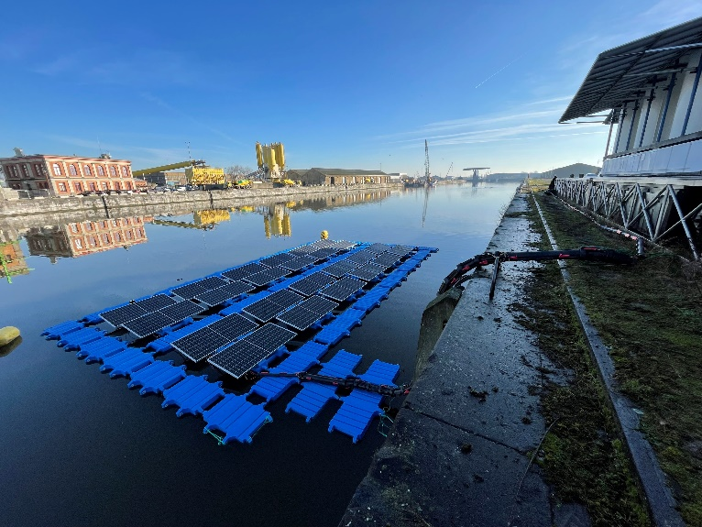
Clean electricity generation through a floating solar technology at near shore location
Summary:
A French company has developed a new wind and wave-resistant floating solar technology for near shore locations. The floating solar technology is already tested in the sea. The French company offers commercial agreement to interested partners as ports, marinas, utility companies and municipalities.
Advantages compared to current solutions:
Cost reduction: electricity price is 2x less than electricity from the grid.
Performance increase: 15% due to the cooling effect of water.
Cost/Watt (EUR/Watt): 2000€/kW
Other advantages:
Floating solar system for near-shore location;
Wind and wave-resistant technology thanks to a patented stability feature;
Flexible and robust connectors;
Passive and cooling system allowing a better efficiency of the solar panels;
Machine Learning.
Additional information, pictures etc.: https://een.ec.europa.eu/b2b/details/0bf40552-aa21-4060-b714-0180f9f9e4df
Contact: Cendrine Carmagnac, c.carmagnac@solutions-eco.fr
Example

